Slide 1

COMPANY HUB
User Guide for Company Account Administrators

Slide 2

TABLE OF CONTENTS
Glossary
Log into your company account
Homepage of your company hub
Edit my profile
Sharers
Endowment
Exhibitors catalogue
Lead Manager App (ex-Emperia) Lead Generation Solution
Manage your company badges
Invite manager
Your Company dashboard analytics
My stand
Register my supplier
Make your show a success
Awards
Need any assistance?

Slide 3
GLOSSARY
Affiliates : Companies or individuals officially attached to the main stand holder, often for the purpose of marketing and sales.
Dashboard : Interface where you can monitor your leads and your company page statistics
Lead Manager App (ex-Emperia) on-site lead capture : Lead Manager app that allows exhibitors to scan visitors' badges at the market and find their contacts in the online dashboard.
Primary administrator : The main contact in your company to prepare the market who has access to the company page, receive Lead Manager App (ex-Emperia) lead notifications, register exhibitor delegates, invite affiliates and add other secondary administrators. Once added, secondary administrators can have the same rights as the primary one (unlimited additional secondary admins).

Slide 4

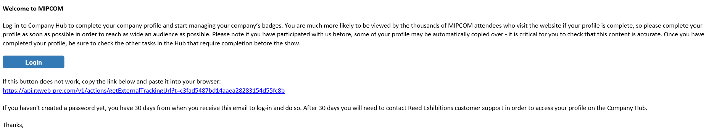
HOW TO LOG IN TO YOUR COMPANY SPACE ?
Once your participation is confirmed, you will receive an email from RX Global : no-reply@rxglobal.com
The link is active for 30 days from receipt of the email.
If you exceed this deadline or if you have not received the email (remember to check your spam), contact our customer service. Help Desk
Click on the link received by email and personalize your password

Slide 5
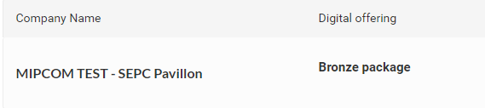
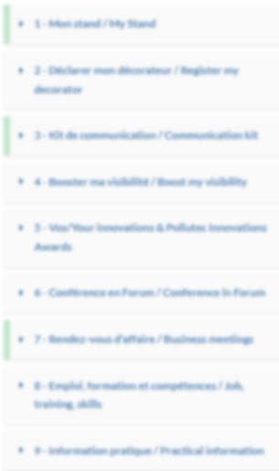
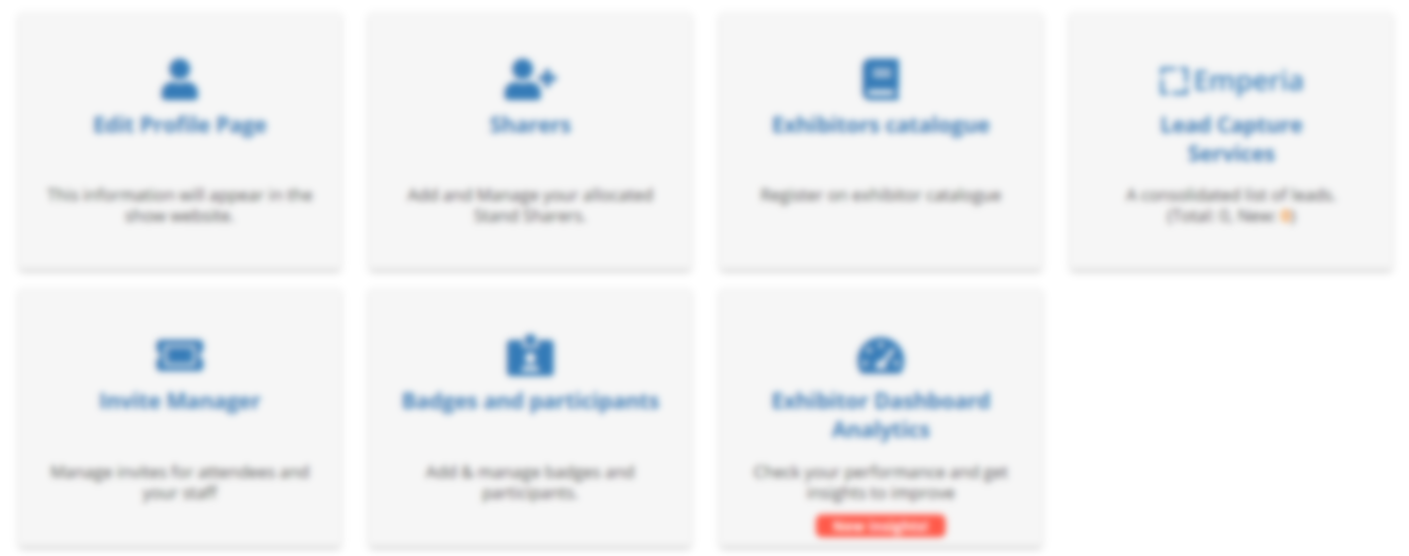
HOMEPAGE OF YOUR COMPANY HUB
Here you will find the name of your company
Here you will find the name of your package type
Here are the details of each section of your Company Hub
You will find here a list of additional resources to complete your preparation for the show

Slide 6
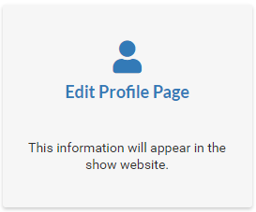
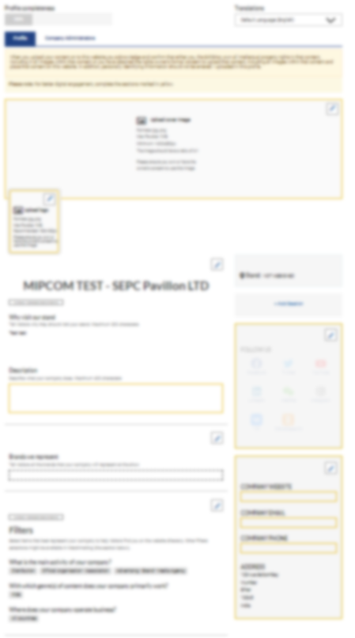
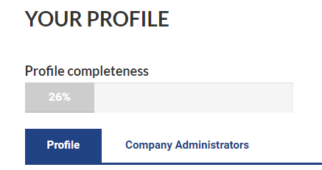
EDIT MY PROFILE
The profile editing section is made up of two parts, one dedicated to editing your company profile, the other to managing/adding other administrators from your company.
Complete all the elements that will be used for:
your listing on the fair's website search engine
your recommendation to visitors who pre-register
Here you will be able to navigate between both parts
Profile
Company Administrators
Access the profile section to modify your company's information
Please complete your company profile with as many details as possible !
Logo, description, cover image... Boost your business opportunities!

Slide 7
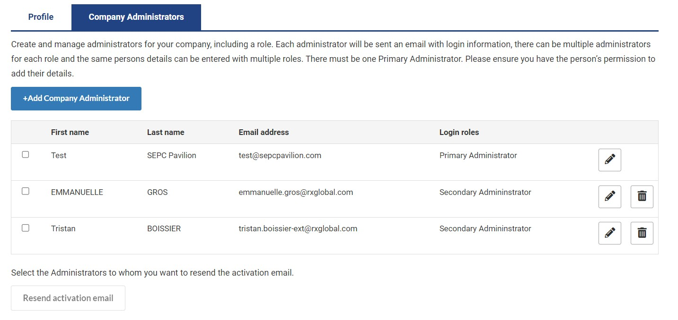

EDIT MY PROFILE - COMPANY ADMINISTRATOR TAB
Exhibitor administrators are individuals from your company who require access to the exhibitor space. Secondary administrators will have the same access as the primary administrator.
Please add any of your colleagues who should have access to the company page full set up.
They will receive an activation email.
Resend the activation email to the company page (in case your colleague did not receive it)
Update your company admins list at anytime

Slide 8
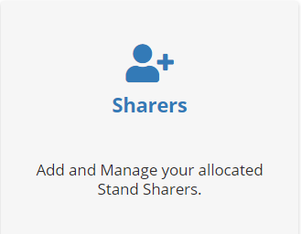
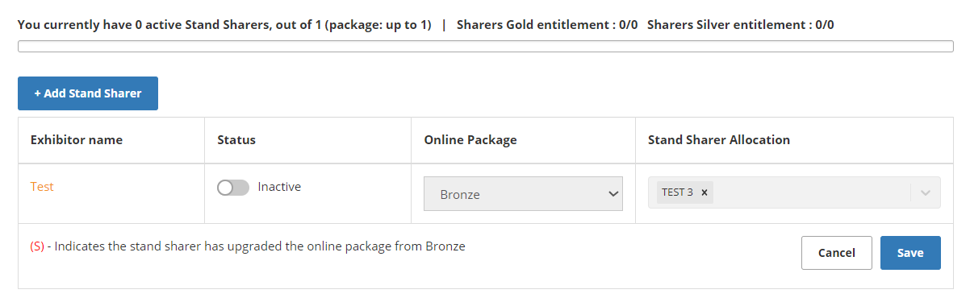
SHARERS
This section allows you to add and manage your sharers, enabling them to access their own space and prepare for the market
Here you can find the number of sharers you have, as well as the types of available packs.
Here the location of your booth is displayed, which cannot be modified, and where the sharer will also be placed
Activate or deactivate the company hub for your sharers

Slide 9
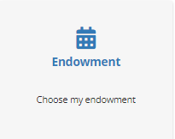

ENDOWMENT
This section allows you to choose the allocation included in the Easy or Identity stand packages. You have the choice between different types of allocations. However, you cannot modify the contents of an allocation.
Please note : your choice of furniture allocation is only finalized after receiving a validation email indicating that the order has been taken into account (remember to check your spam).

Slide 10
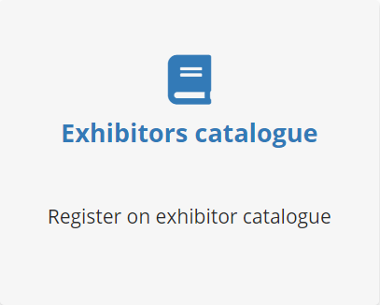
EXHIBITORS CATALOGUE
The Exhibitor Catalogue allows you to register to be visible in the market's printed catalog.
Be aware that registration closes several weeks before the market starts, so we recommend registering as soon as possible.

Slide 11
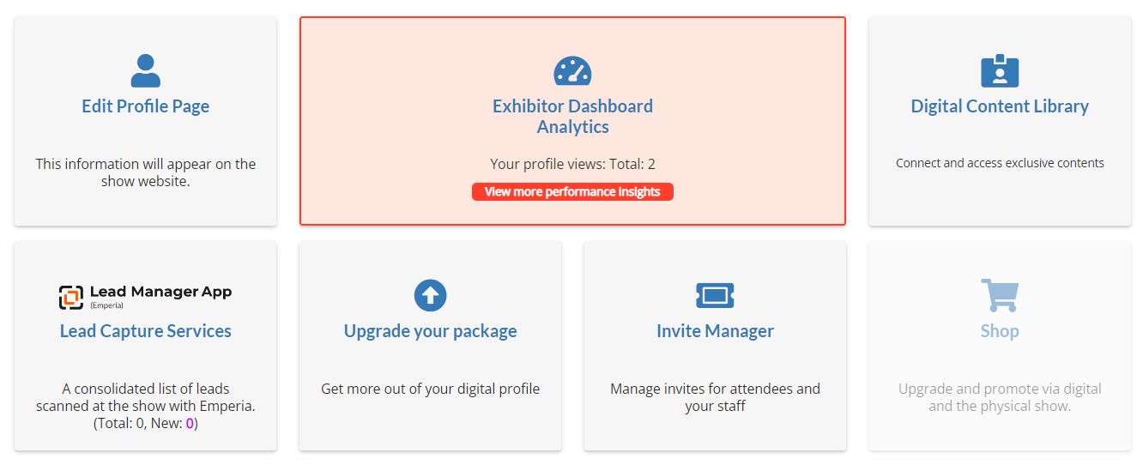
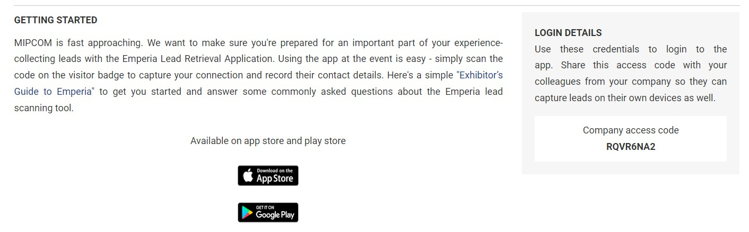
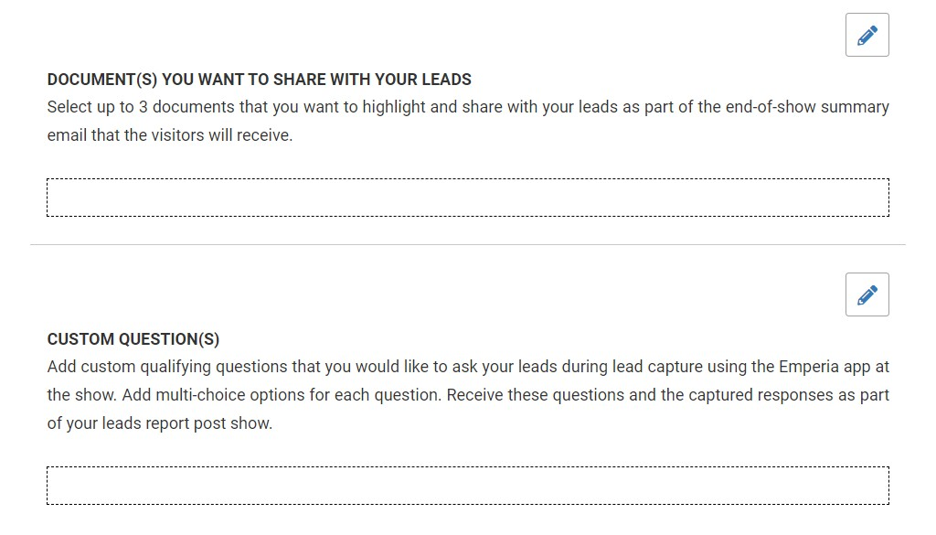
Lead Manager App (ex-Emperia) : THE LEAD GENERATION SOLUTION
Mobile App to scan visitors' badge
Lead Manager App (ex-Emperia) is a mobile app to scan visitors' badges at the exhibition. Collect contacts and find them in your online report available on your exhibitor dashboard.
Customize your account by indicating your company access code
XXXXX
Download the Lead Manager Mobile app from the App Store or Google Play
Upload up to 3 documents about your company sent to the visitors you scan at the show
Add personalized questions. These will be available on your Lead Manager application, so you can easily answer the questions you ask visitors on a recurring basis.

Slide 12
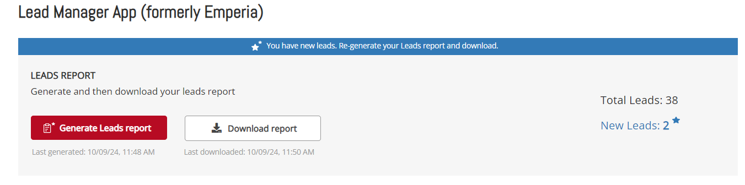
Lead Manager App (ex-Emperia): THE LEAD GENERATION SOLUTION
Download your leads
Every day during the fair or at its conclusion, you have access to visitors who have been scanned by all your collaborators.
At the end of the fair, individuals who have been scanned will receive the documents you have uploaded in the Lead Manager App menu of your exhibitor space, as well as your contact details.
Download the full list of all your online leads and scanned contacts in 1 report available in .csv or .xlsx format

Slide 13
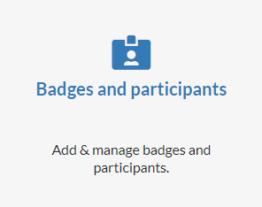

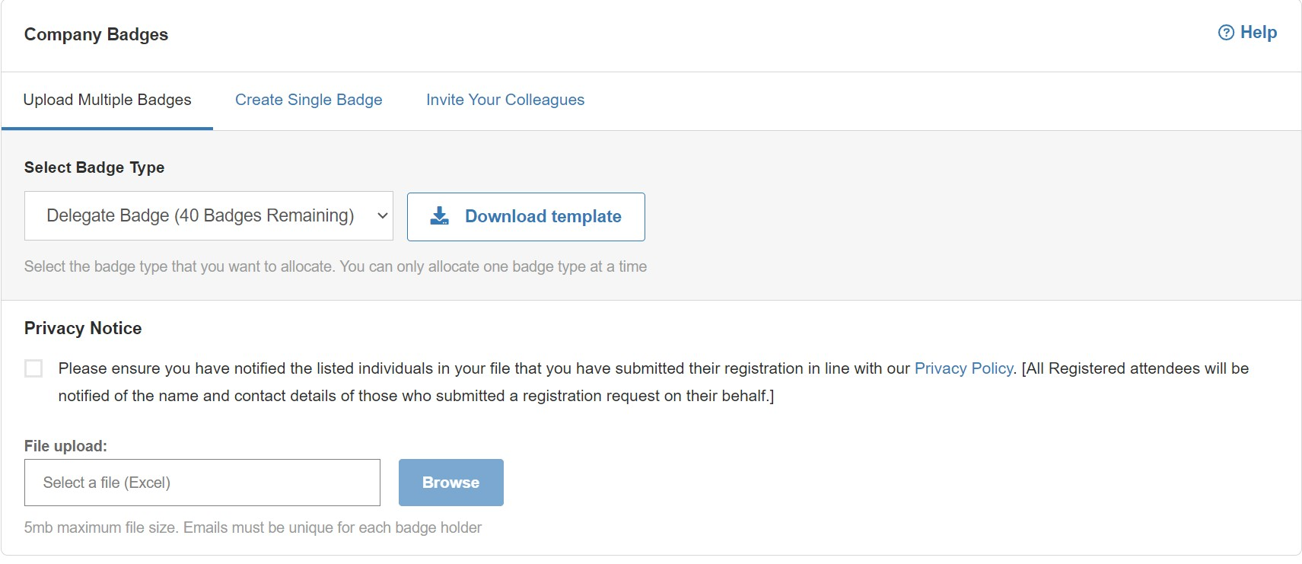
MANAGE YOUR COMPANY BADGES
Managing delegates registrations in your stand quota
Exhibitor badges provide access to the fair before the opening hours for visitors and during the setup and dismantling days.
The Allocate Badges section allows you to add one or more badges for your colleagues.
Here you will be able to navigate between both parts :
Allocate badges
Your company badges
Click here if you want to create a single badge
Use this template to upload multiple delegates at the same time

Slide 14
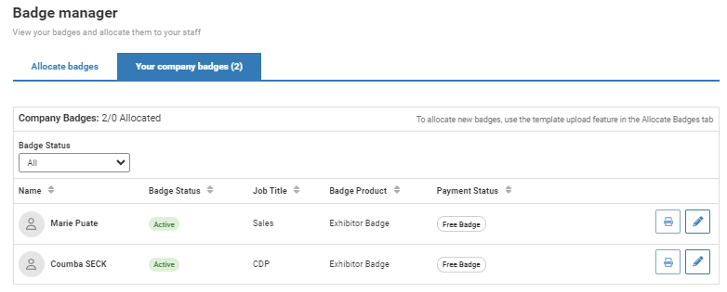
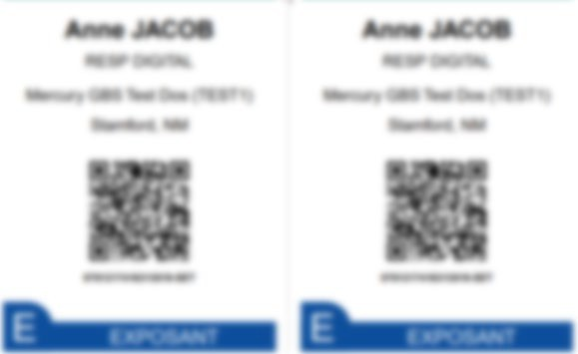
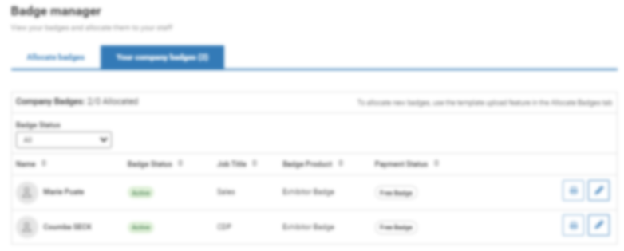
MANAGE YOUR COMPANY BADGES
Managing delegates registrations in your stand quota
Badges are available for download and printing 15 days before the show. However, you must have properly completed your profile in its entirety in advance in order to access your badge.
Get and print your badges using this button.
Here you can find the exhibitor badges you have uploaded
Here you can find the payment status of the badge
You can modify them (with the exception of the email address). If you modify the badge, you will need to re-print as the previous one will no longer be valid.

Slide 15
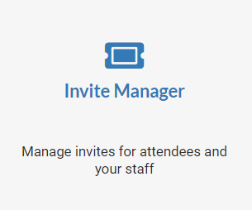
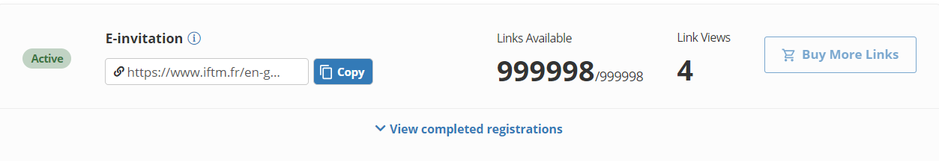

INVITE MANAGER
Invite your contacts to visit you at the exhibition. The generated badge is a valid visitor badge from the opening of the exhibition.
Do not use this feature to create exhibitor badges.
Indicates the number of registrations available.
Indicates the number of registrations available.
Indicates the number of people who have clicked on the link but have not completed the registration.
Copy the link using the button copy
Send this link to the people you would like to invite to the show
Indicate the number of people who have clicked on the link but have not completed the registration.
Copy the link using the button
Send this link to your umbrellas and affiliates
for them to register
You can find the list of people who registered with your personalized link just below

Slide 16
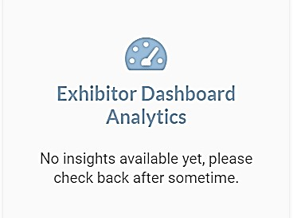
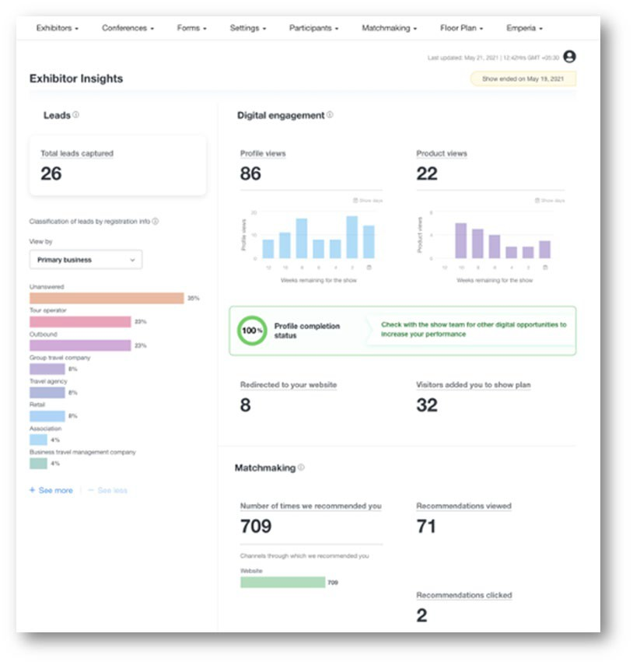
COMPANY DASHBOARD ANALYTICS
The Exhibitor Dashboard allows you to access a wealth of data regarding your performance at the exhibition.
This dashboard synthesizes your leads generated during the show (with Lead Manager app). A large amount of data is available to help you understand the typology of your leads, your strengths, and areas for improvement for your next exhibition.
Its pro version also allows you to compare yourself with your competitors.
This page only becomes accessible 90 days before the show.

Slide 17
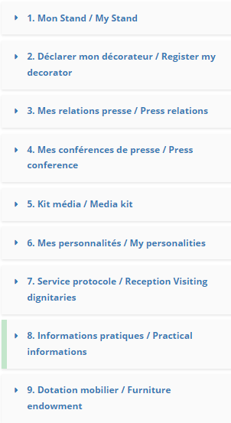
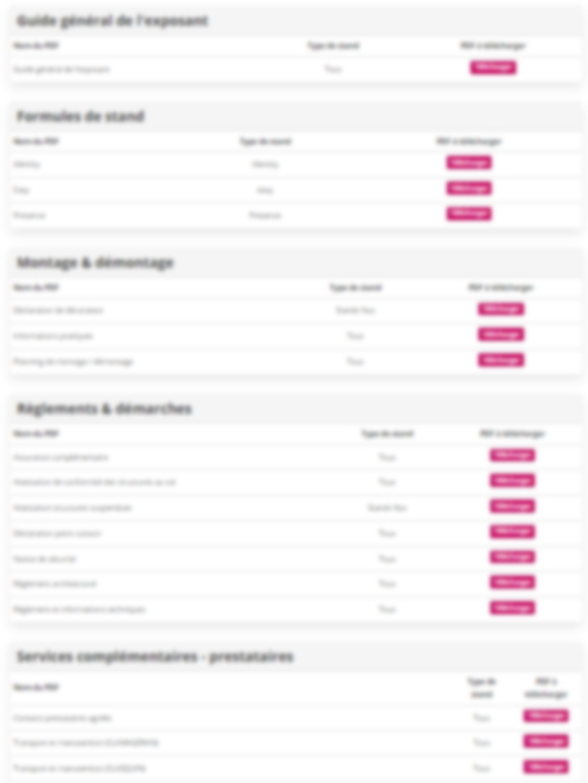
PREPARE MY STAND
Here you will find all the information and documents you need to prepare your stand (stand packages, regulations and procedures, additional services...)

Slide 18
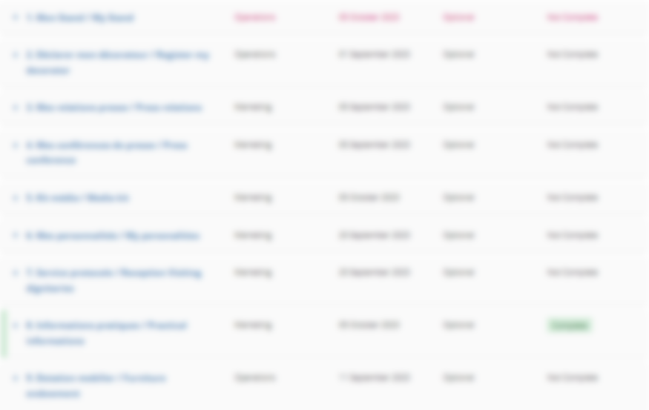
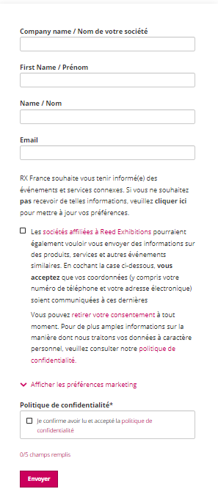

DECLARE MY SERVICE PROVIDERS
Here, declare the supplier(s) who will be working on your stand for the market. This declaration is mandatory and should be made as early as possible

Slide 19
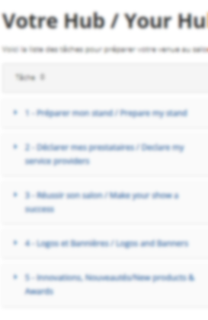
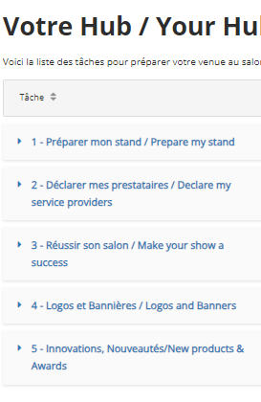
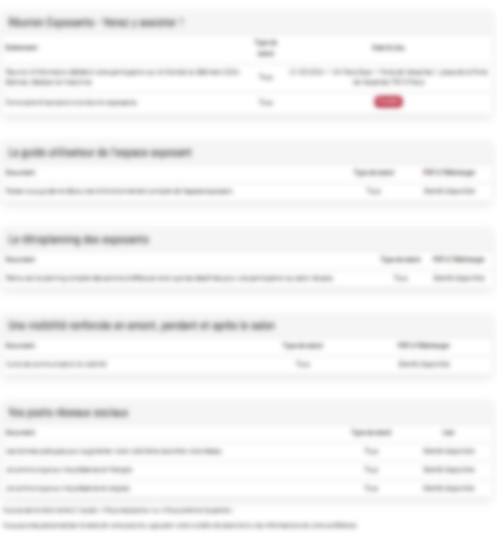
MAKE YOUR SHOW A SUCCESS
Here you'll find all the tools and best practices you need to make your show a success!

Slide 20
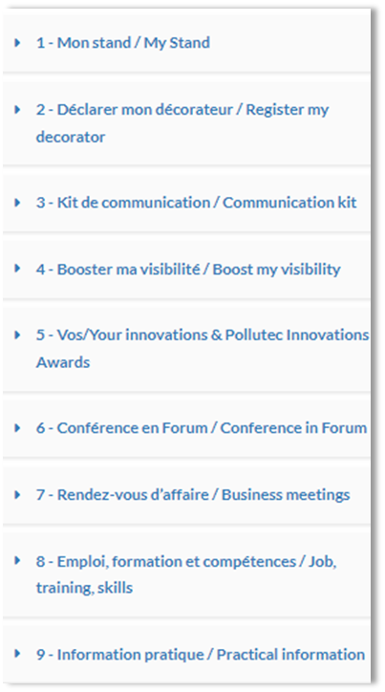
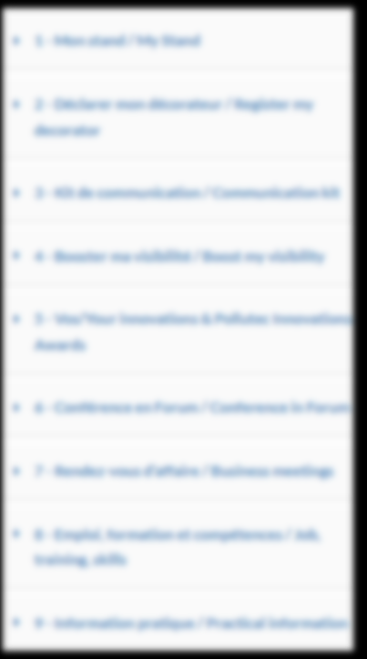
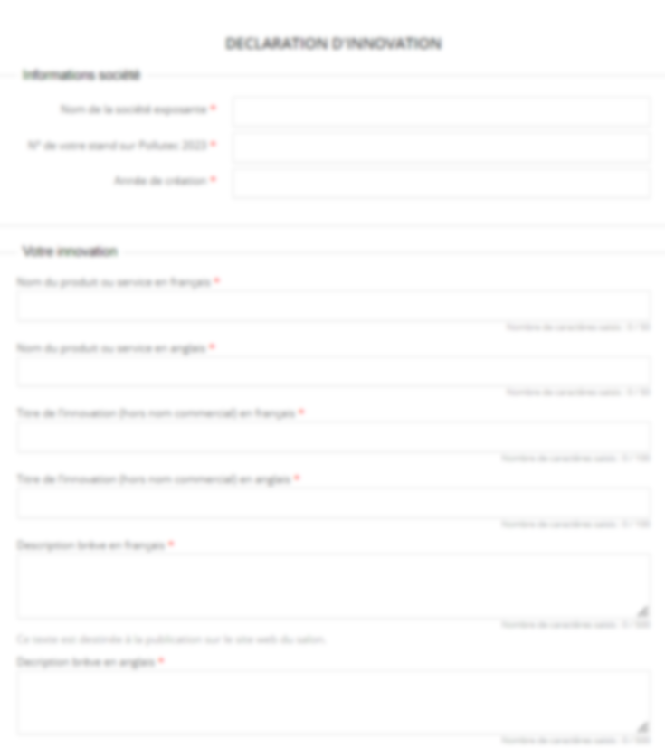

AWARDS
Do you want to show off your innovations? Enter your innovative products or services in the Awards section to take part in our competition !

Slide 21
NEED ANY ASSISTANCE?
Contact our Customer Helpdesk :
By phone : (+33) 1 47 56 50 20.
Our telephone service is open from Monday to Friday, 9am to 6pm CET.
By form
Read the FAQ

